Slide 1
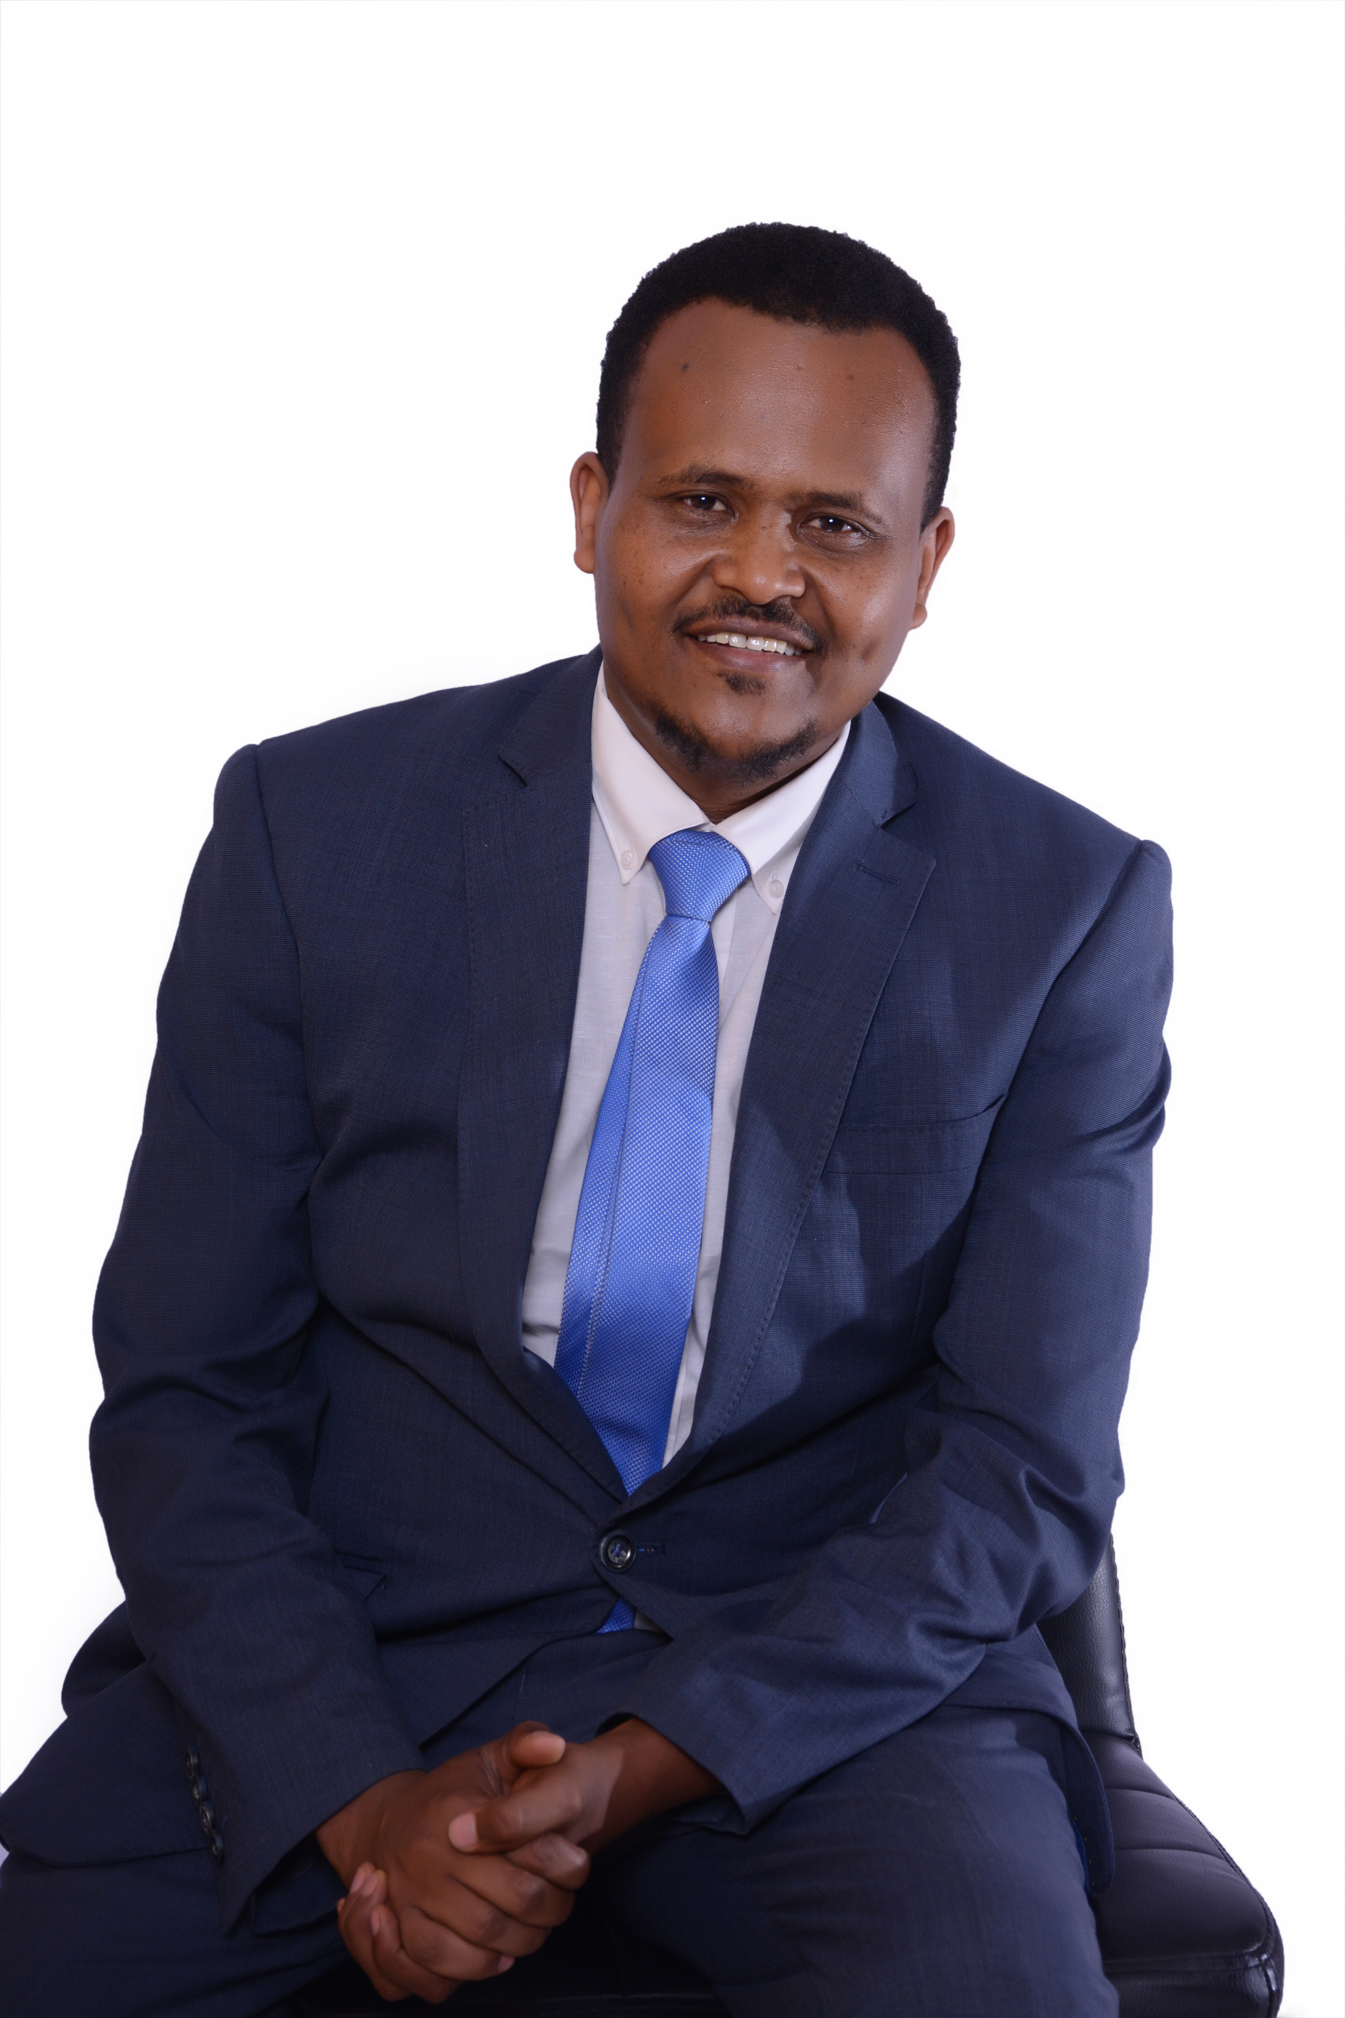
Takaful insurance in Ethiopia : prospects, challenges
By: Fikru tsegaye wordofa

Slide 2
Hello!
I am Fikru Tsegaye W.
(CTP, FLMI,ARA,ACS)
You can find me at fikru.tsegaye@yahoo.com

Slide 3
Outline
Where are we?
Prospects and challenges
The road ahead
Ethio-Re

Slide 4
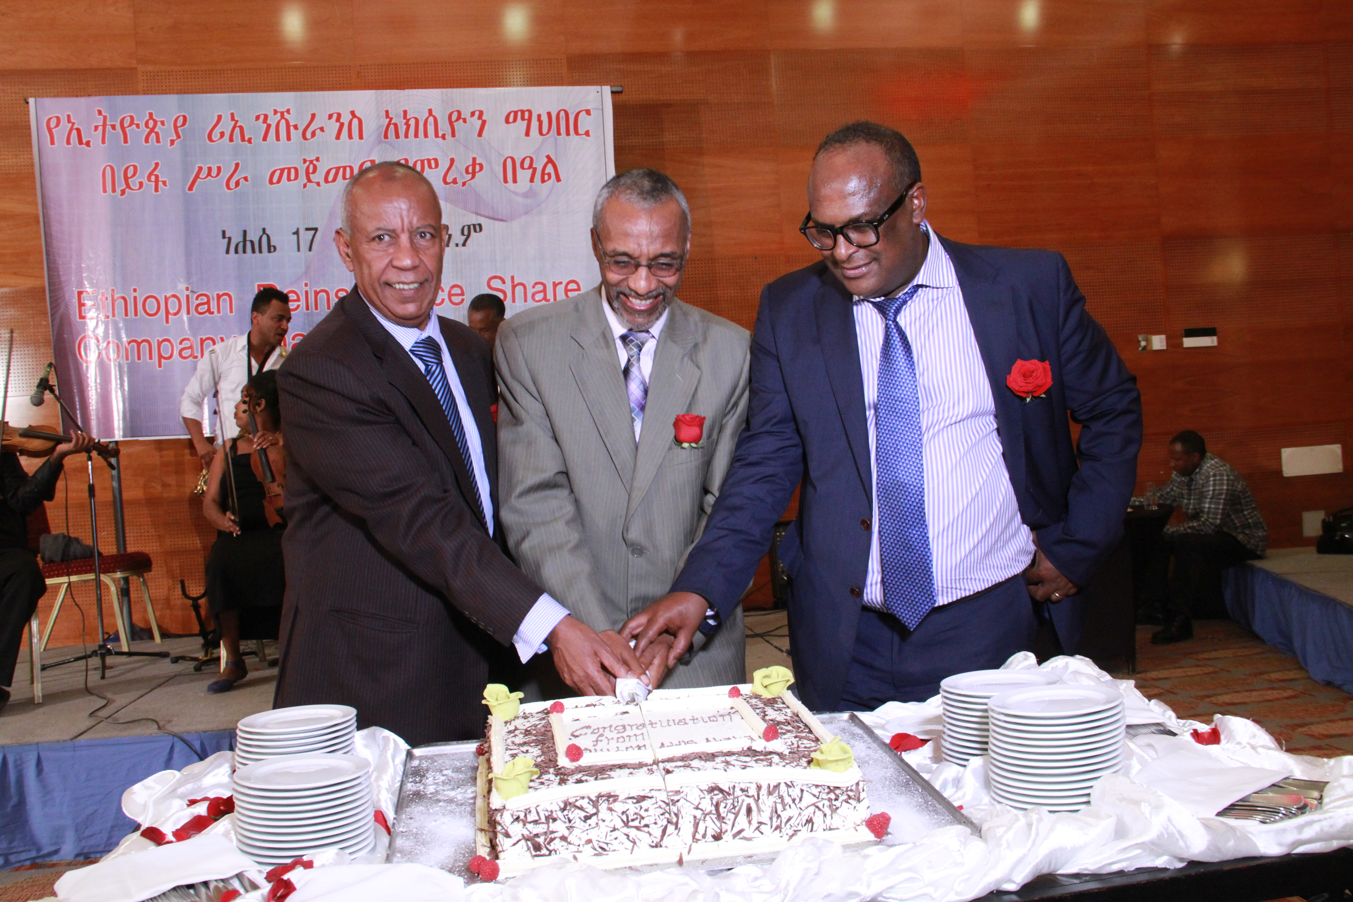
Ethio-Re in a nutshell
Ethiopian Reinsurance S.C a.k.a (Ethio-Re) is the first reinsurance Company established in Ethiopia and the youngest in Africa
It started operation on 1st July 2016. transacting both life and non-life businesses(Conventional & Retakaful)
Public-Private-Partnership (PPP) in the financial sector
Rising with Africa

Slide 5
Shareholdings
Labour Union
0.01%
Individuals
2.33%
Banks
30.76%
Insurance Companies
66.9%
Insurers
17
Banks
7
Individuals
78
Rising with Africa

Slide 6
Capital structure
The legal minimum paid up capital to establish a reinsurance company in Ethiopia is Birr 500,000,000 (Birr Five Hundred Million).
The subscribed capital of Ethiopian Re is Birr 2.5 billion which by any standard is huge for a company just started operation.
Notes:
The management of the recruiting process will directly affect:
The quality and diversity of the applicant pool.
The effectiveness of the interviews.
How quickly the open position gets filed.
The ability to choose the best qualified person for the job.

Slide 7
Ethio-Re -OBJECTIVES
Measure and retain domestic insured risks thereby increasing the capacity of national insurers to take on risks within comfortable margin.
Assist the growth of primary insurance business in the country by way of providing technical and advisory back up both in general and long-term insurance.
Enhance professionalism in the insurance industry.
Mobilize investment funds by making use of collected reinsurance premium.
Prevent undue outflow of hard currency.
Generate foreign currency through inward reinsurance business.
Rising with Africa

Slide 8
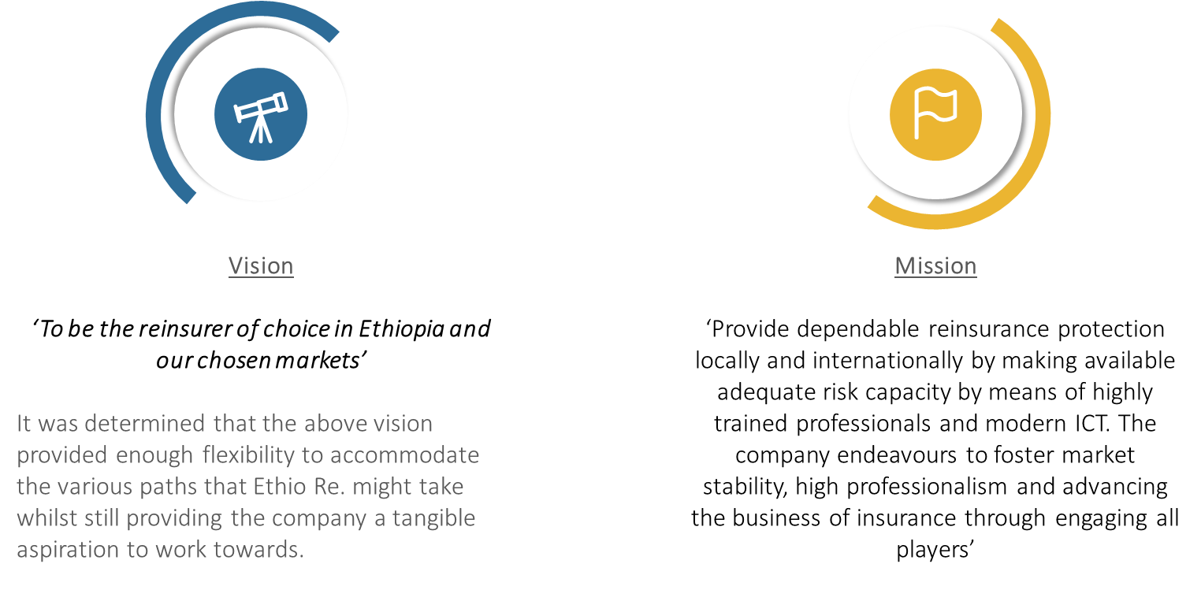
2030
Notes:
The management of the recruiting process will directly affect:
The quality and diversity of the applicant pool.
The effectiveness of the interviews.
How quickly the open position gets filed.
The ability to choose the best qualified person for the job.

Slide 9
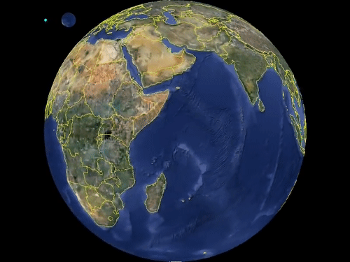
OUR FOREIGN PRESENCE-IN AFRICA-over 6 COUNTRIES AND 10 COMPANIES
Source of our Foreign Book | Our Share on the Treaty
Ghana Re( Kenya) | 5%
The United Insurance Company of Sudan | 2%
Middle East Insurance Company | 1%
Albaraka Insurance Company( Fire 2nd Surplus*) | 3.5%
Uganda Re | 10%
East Africa Re | 10%
Ghana Re( Ghanna) | 5%
WAICA Re | 5%
Continental Re | 3.50%
CICA Re | 3.50%

Slide 10
STRONG REGULATORY SUPPORT.
Directive No.SIB/44/2016 (Manner and criteria of transacting reinsurance business)
An insurer to cede at least 25% of its treaty business;
5% of each policy issued by them.
In addition, the Company also has the right of first refusal in respect of all facultative placements.

Slide 11
Products and reinsurance solution
Ethio Re provides all life and non-life reinsurance covers except energy, oil and gas.
Fire and engineering;
Accident and motor;
Marine and aviation;
Life and health;
Non demand bonds;
Liability;
Retakaful
Agriculture and Political Violence and Terrorism (PVT); and
Others
Rising with Africa

Slide 12
Our Headline Goals

Slide 13
Where are we now at industry level?

Slide 14
Takaful products can be offered in other different names such as Islamic insurance, Halal insurance, ethical insurance, Islamic mutual insurance, Sharia compliant Insurance, co-operative insurance and community insurance.
In Ethiopia, studies have convincingly shown that the potential for General and Family Takaful exists and
Accordingly, National Bank of Ethiopia (NBE) , has issued a directive to license a Takaful Operator or authorize a Takaful Window Operator No. STB/1/2020 in accordance with Article 60(1&2 and 64(2) of the Insurance Business Proclamation No. 746/2012 as amended by the Insurance Business (amendment) Proclamation No.1163/2019.

Slide 15
The Regulatory Landscape

Slide 16
Ethiopia: Banking sector is a pioneer
The financial market in Ethiopia has predominantly been conventional.
2008
NBE indicated Islamic finance on the banking proclamation of 2008
2011
(NBE) has issued a directive in September 2011 allowing the provision of interest free banking services through dedicated windows in branches of conventional banks.
During this period interest free banking services has only contain less than 1% of the banking portfolio in Ethiopia.

Slide 17
Insurance: Regulatory landscape: developments so far
2018
Efforts to create a more hospitable climate for “Islamic financial Services” have been renewed since Prime Minister Abiy Ahmed came to power in April 2018.
2019
NBE, has allowed fully Islamic law-compliant financial institutions, late June 2019.
2020
The National Bank of Ethiopia’s Directive No.STB/1/2020, a Directive to license a takaful operator or a takaful window operator,-effective 15th day of June 2020

Slide 18
Islamic financial institutions(2021/22)
Islamic banks
Full fledged/2/windows (more than 12)
Insurance (3)/reinsurance (3)companies- window service
Islamic micro finance institutions(5)

Slide 19
Directive No.STB/1/2020.
It’s an achievement we have been crying for years;
NBE: has done its homework
Takaful operator(full-fledged)/takaful window operator(branch alongside conventional)
Family(life)/General takaful(non-life)
Operating model-Defines the fiduciary relationship between participants and takaful operators
Otherwise, mutatis mutandis- with all prescribed under insurance proclamation 746/2012 and amendment NO. 1163/29

Slide 20
Special requirements -STB/1/2020.
Authorization from NBE(application for authorization+ Feasibility study)
Separate Policy and procedures on Sharia oversight
Sharia Advisory council (SAC)- in addition to the Board-acts as advisory body on Sharia principles
SAC consists 3 members(knowledgeable in insurance, Sharia scholar, adequate expertise in financial services)

Slide 21
Operators shall have .
Organ: Separate unit
Manpower: Head of takaful operations
Segregation: Set separate account
Visibility: Takaful windows are displayed visibly
Operating model;
Maintain documentation- separate contact governing relationship and transaction with participants;
Fund policy/investment policy and calculation of profits/recognition of deficit

Slide 22
Disclosure and transparency-.
publish details of the model and with sharia principles
Understandable language and minimum technical jargons
Inform participants with in seven days -change or modification
Submit quarterly report to NBE – as per the template and format prescribed under SIB/38/2014

Slide 23
Operators shall have .
Remuneration to the takaful operator/window operator
Segregate assets of participants/ from assets of shareholders
Separate fund/bank account for family and general takaful
Surplus distribution subject to recommendation by actuary /external auditor , endorsed by SAC and approval of the board and NBE
Surplus distribution is subject to generally accepted actuarial principles
Distribution as per the contract

Slide 24
Improvements
Retakaful:
Barely makes mention of retakaful
7.1.3 :Ensure that the claims and retakaful are paid from participants funds
Relationship, manner and terms with reinsurers
Re-takaful contributions
2. High authority for SAC
All expenses must have been approved by SAC
The role of SAC is huge
Investment, promotion, claims

Slide 25
Improvements
3. Investment:
Detail investment areas (sharia compliant)
List of approved investment options
4. Takaful is for all: Takaful is also for the non-muslims
Takaful is being appreciated by non Muslims
This is due to the fact that takaful provides an attractive alternative for insurance protection with different investment objectives that gives the option of surplus distribution.
5. Micro-takaful
6-Bancatakaful

Slide 26
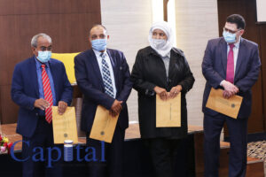
Insurers-so far
18 insurers
Global Insurance Company has become a pioneer to introduce Takaful Insurance service in the country;
NILE, AWASH.LICENSED
Others are on development stage

Slide 27
BancaTakaful as alterntive

Slide 28
BancaTakaful: efficient distribution channel
Bancatakaful is a term referring to the selling of insurance through a bank's established distribution channels.
The provision of and selling of banking and insurance products under the same roof -in partnership- with digitalization it has become -Omnichannel customer engagement
Banks become
“one stop”
“Financial supermarket”

Slide 29
Customers
Banks
Insurers
Society at large/macro level
Enhanced convenience
One stop shopping- basket of products under one roof
More credible solution-trust
Ease of premium payments-using bank account /technology
Revenue in the form of service charge and business diversity-increase shareholder value
Addtional income with little marketing cost
Differentiator-One stop shopping for customers –bundling
Outlets efficiency maximization- can use their existing staff/ resources
Wider portfolio
Revenue and channel diversification-cross -selling /up -selling
Introduction of co- branded services
Leverage Customer access-Bank retail and corporate customers database that would otherwise not be accessible –segmentation
Cost reduction-distribution costs go up to 50%- can offer affordable products with competitive rates
Improved brand equity-competitive advantage
Improved penetration, density & branch to population ratio;
Ease of renewals/lower lapse rates
Increasing financilal inclusion and access to financil services
Increased GWP and the contribution of the sector for GDP increases- GDP growth

Slide 31
Ethiopia: Potential-population-BIG MARKET
The most populous landlocked country in the continent of Africa and the second-most populous country of Africa after Nigeria, the 14th most populous country in the world.
If Ethiopia follows its current rate of growth, its population will double in the next 30 years, hitting 210 million by 2060. (http://worldpopulationreview.com/countries/ethiopia-population/2018)
Moreover, as Ethiopia has over 110 million, predominantly young and growing middle class population, there is greater demand for the service

Slide 32
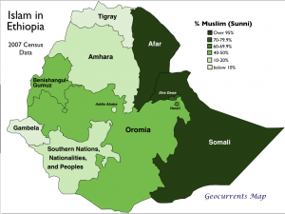
Demographic
It is important, however, to put the significance of Ethiopia’s Muslim population in perspective.
Estimates put the total number of Muslims in Ethiopia more than the number of Muslims in Saudi Arabia, Syria or Yemen and almost as many as in Sudan.
All these provide potentials to broaden Islamic finance in general and insurance coverage using takaful, in particular.

Slide 33
Potential: religious base
Islam in Ethiopia is the –one of the most widely practiced religion.
Islam is the religion of the overwhelming majority of the Somali, Afar, Argobba, Hareri, Berta, Alaba and Silt’e and also has many adherents among the Gurage and the Oromo, the largest ethnic group in Ethiopia.

Slide 34
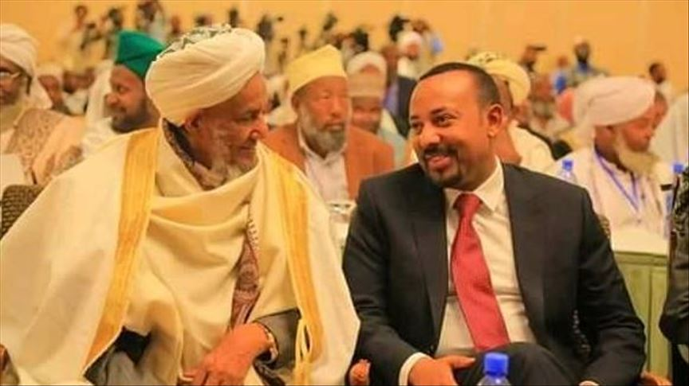
Strong religious base
Ethiopia has close ties with all three major Abrahamic religions.
Ethiopia has the first Hijra in Islamic history and the oldest Muslim settlement on the continent. The religion is deeply rooted in Ethiopia;
Early in the 7th century a group of Arab followers of Islam in danger of persecution by local authorities in Arabia took refuge in the Axumite Kingdom of the Ethiopian highlands.
As a result of this generosity, the Prophet Mohammed concluded that Ethiopia should not be targeted for jihad.

Slide 35
Challenges in Ethiopia

Slide 36
Regulatory concerns
Gaps in the regulatory front:
Comprehensive directives
Experience of NBE on takaful
Trained manpower –scarcity of human resources

Slide 37
Human resources-Takaful Operators
lack of skilled manpower in the field.
Hence trainings and experience sharing exercises should be undertaken with those countries having rich exposure in the field.
Adequate training coupled with sufficient incentive system could motivate staff to join the sector;
Less advancement of technology

Slide 38
Potential mis-selling:
Data and information
Product knowledge
Distribution challenge and cost
Awareness creation
Risk management
Internal control

Slide 39
Awareness creation
Public awareness-What, why, concept, difference..etc
Economic and spiritual benefits of takaful
Working with group of religious scholars (ulama)
Takaful is for all- non muslims
Media-channel of communication
Different models- understanding variances

Slide 40
ICT
ICT development
Modern services
lack of standardization,
technical efficiency, operating efficiency,
Inadequate technology development

Slide 41
Others
Rural market,
Micro takaful
small penetration rate,
differences in culture,
non- sharaih compliance risk, operating efficiency,
income level of participants,

Slide 42
The road ahead

Slide 43
The future of takaful - Requires the conerted effort of all
Exploit the untapped potential
NBE- Create enabling regulatory environment
Policy makers- The potential of islamic finance
Result= alternative service, penetration, density, contribution of insurance to GDP, accessibility,….

Slide 44
Narrow the gap
Insurers- Understand the takaful aspects but lack knowledge of sharia principles and the real demand of the people,- come up with real solution
Religious scholars- know the sharia principles but barely understand the principles of takaful
Together avoid myths and biases

Slide 45
Insurers and customers are starting to realise that:
There is a significant market for takaful; •
Takaful products can be price competitive with conventional insurance products; and
Takaful is inherently ethical and is obliged to invest in ethical products.
This combination of ethical investment policy, significant growth potential and price competitiveness makes for a compelling business proposition to nonMuslims as well
The potential for takaful is beyond question. But there are many hurdles to overcome if this market is to realise its potential.

Slide 46
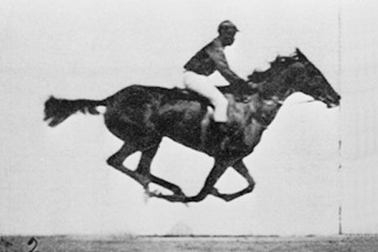
Insurers
Train staff-capacity building
Experience sharing
Understand the demand gap
Develop appropriate models
Educate the public

Slide 47
Banks
Shy away from traditional services and offer products in bundle to maximize customers service quality and efficiency;
Develop generalist- multi tasking employees –
Bancassurance- part of their strategy
In today’s Insurance market, some studies have shown that cost of distribution accounts over 50%;

Slide 48
The legal and regulatory wing
Enabling regulatory landscape:
Improved regulations spur Takaful growth;
Clear Policies and strategies with regard to the insurance sector in general : Addressing the challenges related to infrastructural, technology, consumer protection, and business drivers affecting bancatacaful /TAKAFUL, in particular
Regulators must be supportive in all aspects by setting the necessary directives

Slide 49
Government
political will whereby genuine support from the government is needed for the effective introduction of Islamic insurance or takaful
This support should be subsequently followed by broad publicity of the newly introduced industry, an amendment of the laws, and the development of the necessary infrastructures to facilitate an effective collaboration with international organizations.

Slide 50
Regulatory concerns
Clarify roles and responsibilities
Avoid potential conflicts of interest for bank-led insurers , contagion and reputational risks.
Setting clear directives and operating guideline in:
Agents models,
Investment directive, ...etc

Slide 51
The role of Media-promotion
Awareness creation and promotion strategy is needed
To educate the public and improve financial literacy
Takaful: A viable alternative for anyone seeking to manage financial risk: not only for Muslims
to remove the myth that Takaful insurance only belongs to Muslim community only
Stronger voice –to takaful

Slide 52
Technology and HR capacity
Technology- to provide fast and efficient services for customers
Develop HR capacity of leadership(Board and management) and employees of banks, insurers, reinsurers and the regulator

Slide 53
Human Resource concerns
Lack of technical competence.
Bank employees are unable to manage complex insurance programs required by commercial clients .
Adequate training coupled with sufficient incentive system could avert the staff resistance, if any
Less advancement of technology

Slide 54
TAKAFUL-RE
Retakaful is a “Takaful for Takaful operators”
Reinsurers should avail the necessary capacity
i.e. the existing reinsurers /new takaful reinsurance companies
There is an opportunity for retakaful operators to assist the growth and expansion of takaful insurance.

Slide 55
Concerned stakeholders
As always, my recommendation is intended to draw the attention of policy makers- design a clear and participatory policy and strategy addressing the insurance sector
can be a panacea for addressing structural problems and even the odds of the industry that hampered its growth and development

Slide 56
Further research
Demand gap
Product suitability
Marketing strategy
Models
Investment options

Slide 57
Credits/References
Special thanks to all the people and institutions whose work I used in this presentation:
Insurance industry data from National Bank of Ethiopia (NBE)
Research works, books and articles on takaful
PricewaterhouseCoopers Takaful: Growth opportunities in a dynamic market Insurance

